Slide 1

Transfer Learning for Sentiment Analysis Using BERT Based Supervised Fine-Tuning.
Project part A
23-2-R9
Students: Dorin Bachar 313603367 Moshe Moalem 205802945
Supervisors: Dr. Renata Avros Prof. Zeev Volkovich

Slide 2
Table of contents
01
05
The Project Goal
Bangla-BERT
02
06
Introduction
Transformers
03
07
Sentiment Analysis
Bert
04
08
Workflow
CNN-BiLSTM

Slide 3
The Project Goal
Adaptation of the Transformer model for text authorship attribution.
Leveraging the power of fine-tuning to customize the model for our specific task.
The transition from the model's original use-case of sentiment analysis to binary text classification.
For example, Two distinct classes for classification:
1. Authored by Shakespeare.
2. Not authored by Shakespeare.
The ultimate goal is to accurately determine if a given text was written by an author, showcasing the benefits of using Transformer architectures.

Slide 4
Introduction
Exploring Sentiment Analysis: A essential part of Natural Language Processing(NLP) applications.
Introduction to BERT: A top-notch model partially used also in sentiment analysis.
The Power of Fine-Tuning: Using transfer learning to adapt BERT to specific tasks.
Meet Bangla-BERT as a basic model.

Slide 5

Sentiment Analysis
Sentiment analysis is a text mining tool that helps to understand emotions and personal opinions expressed in a text.
It is used to enhance different services, for example, reviews of movies, products, and restaurants, and can even help figure out who wrote a text.
Most frequently, sentiments are sorted into three groups: positive, negative, or neutral.

Slide 6
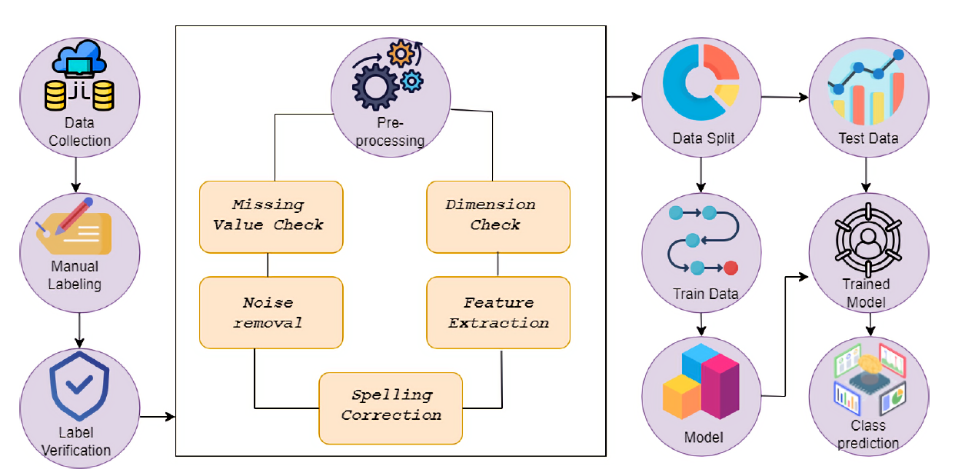
Project Workflow
Unknown authors
A specific author
Positive
Negative
Bangla-BERT

Slide 7
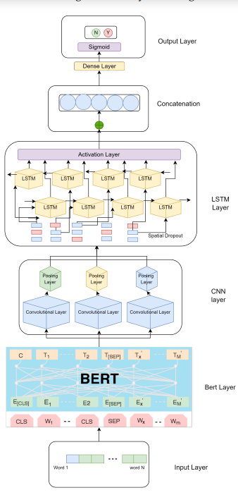
Bangla-BERT Architecture
Word Embedding - BERT converts words from a given dictionary into numeric vectors.
CNN Layer - The model extracts essential information from the numeric vector arrays.
LSTM Layer - The layer extracts sequential text information.
Output Layer – A fully connected layer provides the final text categorization.

Slide 8
Transformers
What is Transformers?
Transformers, introduced in 2017, is an innovative NLP tool that leverages self-attention mechanisms to process text sequences simultaneously, capturing dependencies between words through relevance-based weight assignment.
The architecture is built from an Encoder and Decoder, each with multiple identical layers. The Encoder processes the input sequence while the Decoder generates the output sequence.
Transformers have brought advancements in various NLP tasks such as machine translation, sentiment analysis, and question answering.

Slide 9
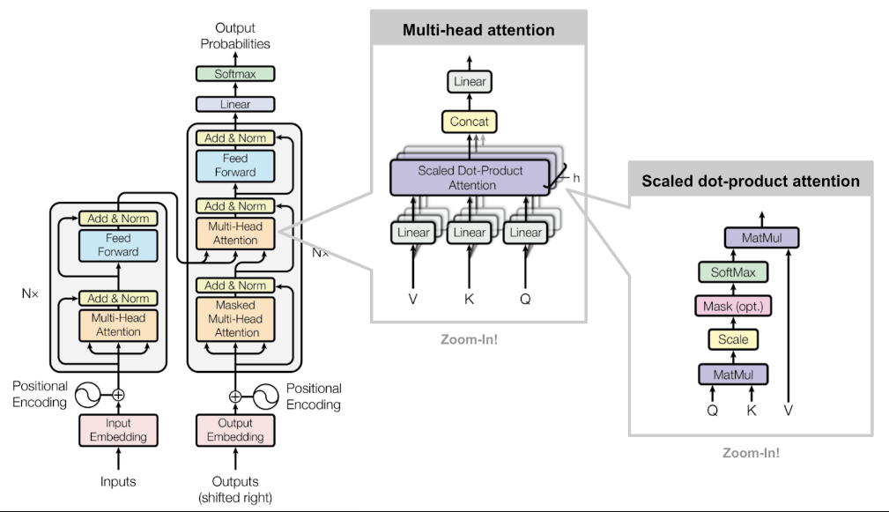
Transformers Architecture

Slide 10

BERT
A transformer developed by researchers at Google AI Language in 2018.
BERT, standing for Bidirectional Encoder Representations from Transformers.
BERT reads a text in both directions aiming to understand the context.
This bidirectional approach enhances the model's understanding of language semantics.
In our project, BERT is applied to sentiment analysis tasks.

Slide 11
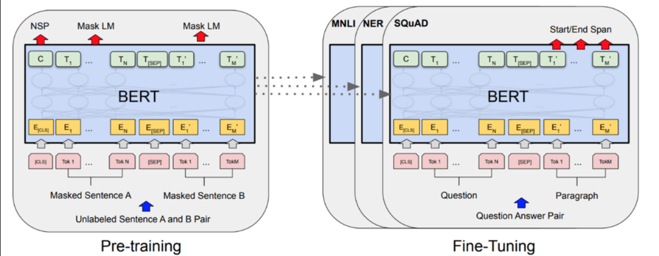
BERT Training Process
Two-Stage Training Approach:
Pre-training Tasks:
Trained on unlabeled data for learning language representation while using 2 methods:
Masked Language Modeling (MLM) to understand the correlation between words in the same sentence.
Next Sentence Prediction (NSP) is to understand the correlation between different sentences.
Fine-tuning Process:
Train the model with labeled examples related to the specific task such as classification while potentially adding additional layers to help with that task. While Fine-Tuning process all the weights is updated including the pre-trained weights, using backpropagation and optimization techniques.

Slide 12
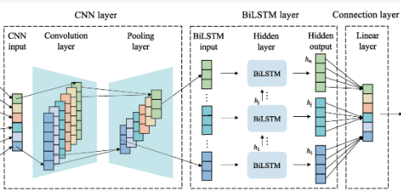
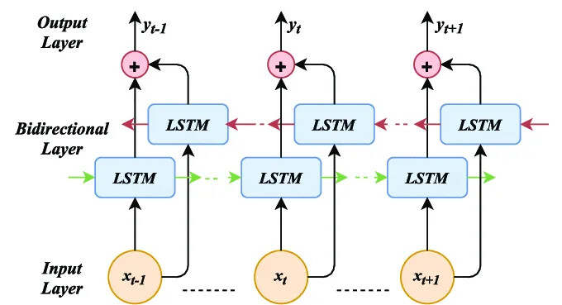
CNN-BiLSTM
CNN-BiLSTM combines the strengths of Convolutional Neural Networks (CNNs) and Bidirectional Long Short-Term Memory (BiLSTM) networks.
CNNs excel at identifying local patterns in data.
BiLSTM - Bidirectional LSTM layers for capturing contextual information in both forward and backward directions.
Feedforward Neural Network (FNN) that calculates the loss and makes the binary classification output - written by a specific author or not.

Slide 13
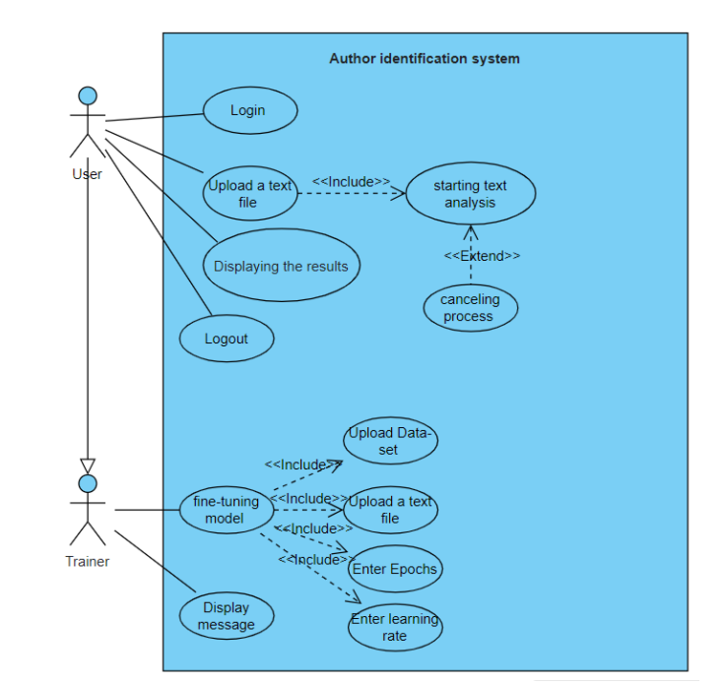

Slide 14
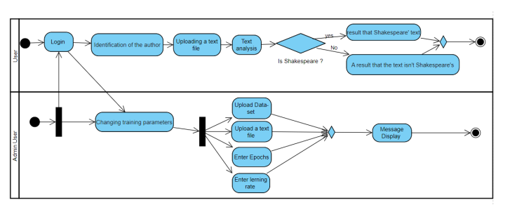

Slide 15
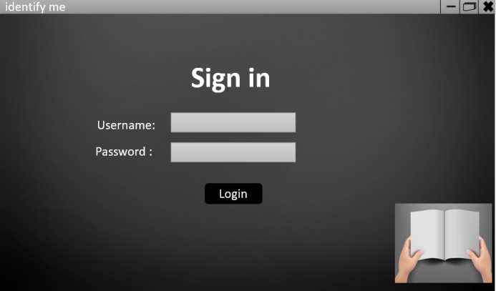
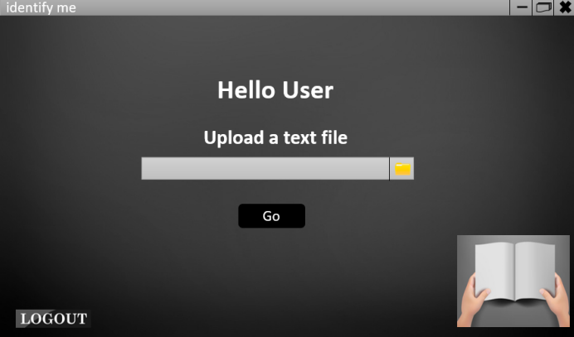
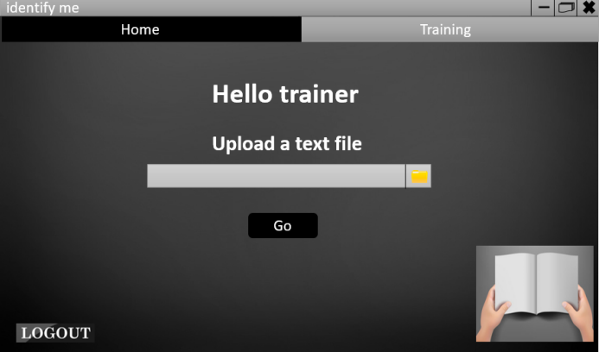

Slide 16
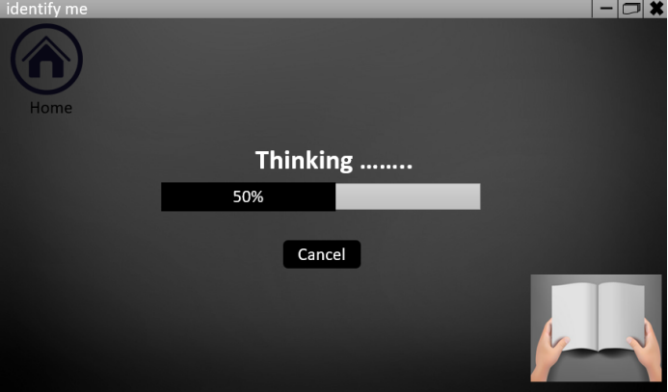
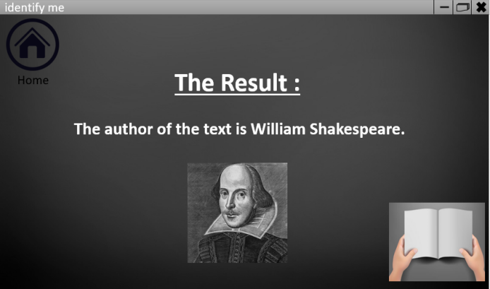
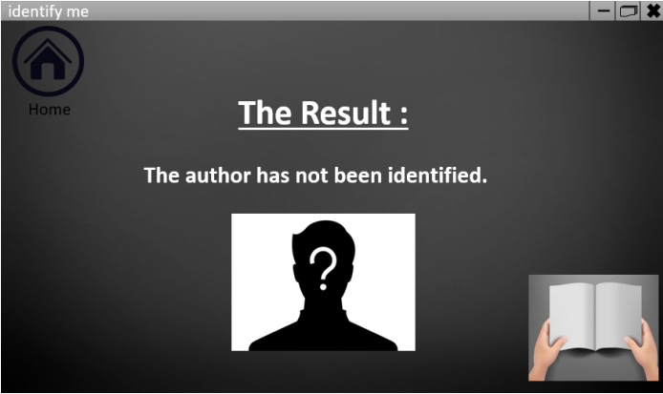

Slide 17
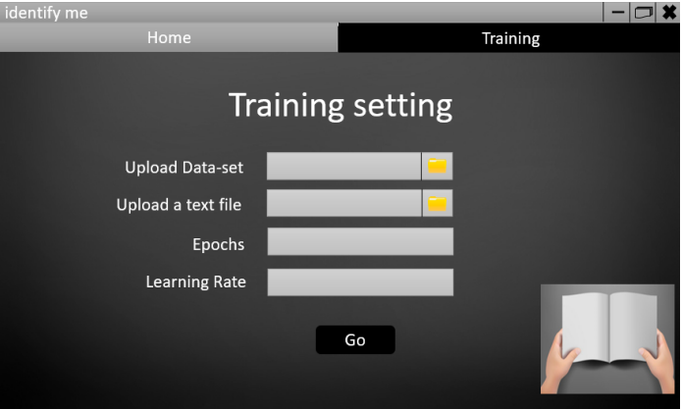

Slide 18
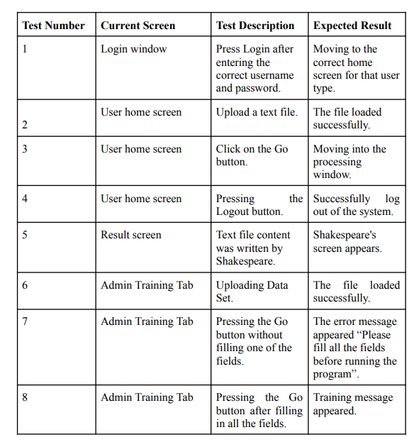

Slide 19
Thanks for listening
Dorin Bachar Dorin.hila.bachar@e.braude.ac.il
Moshe Moalem Moshe.Moalem@e.braude.ac.il

